Slide 1
Web VR
COMP 531
Chongzhang “Christopher” Li
cl46@rice.edu

Slide 2
Outline
VR Basics
WebVR Overview
WebVR code demo

Slide 3
VR BAsics

Slide 4
What is VR?
Hacking user’s perception system to fully immerse the user into a virtual experience.

Slide 5
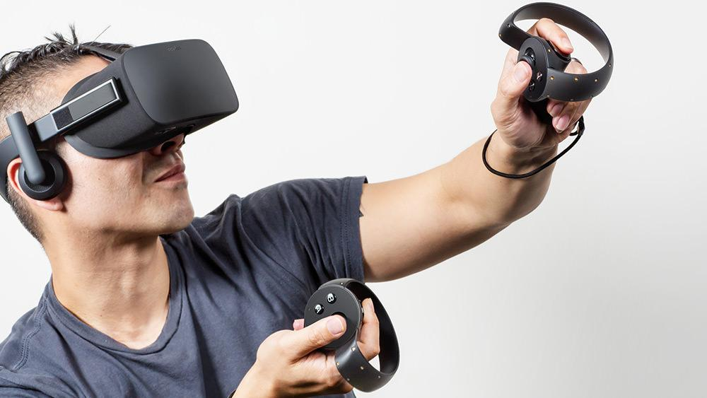

Slide 6
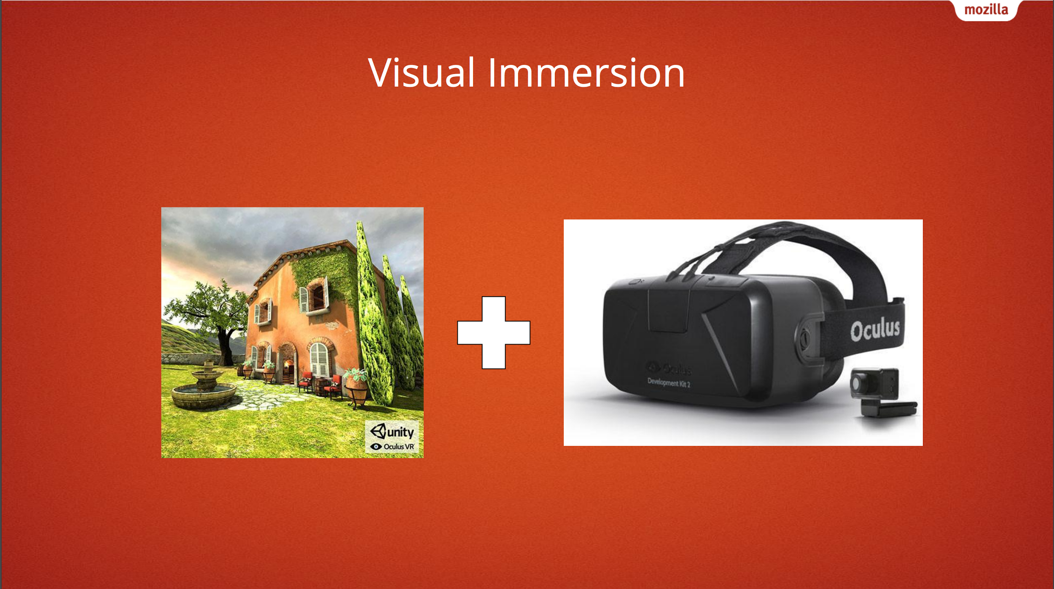
Credit: https://people-mozilla.org/~vladimir/misc/webvr-fitc.pdf

Slide 7
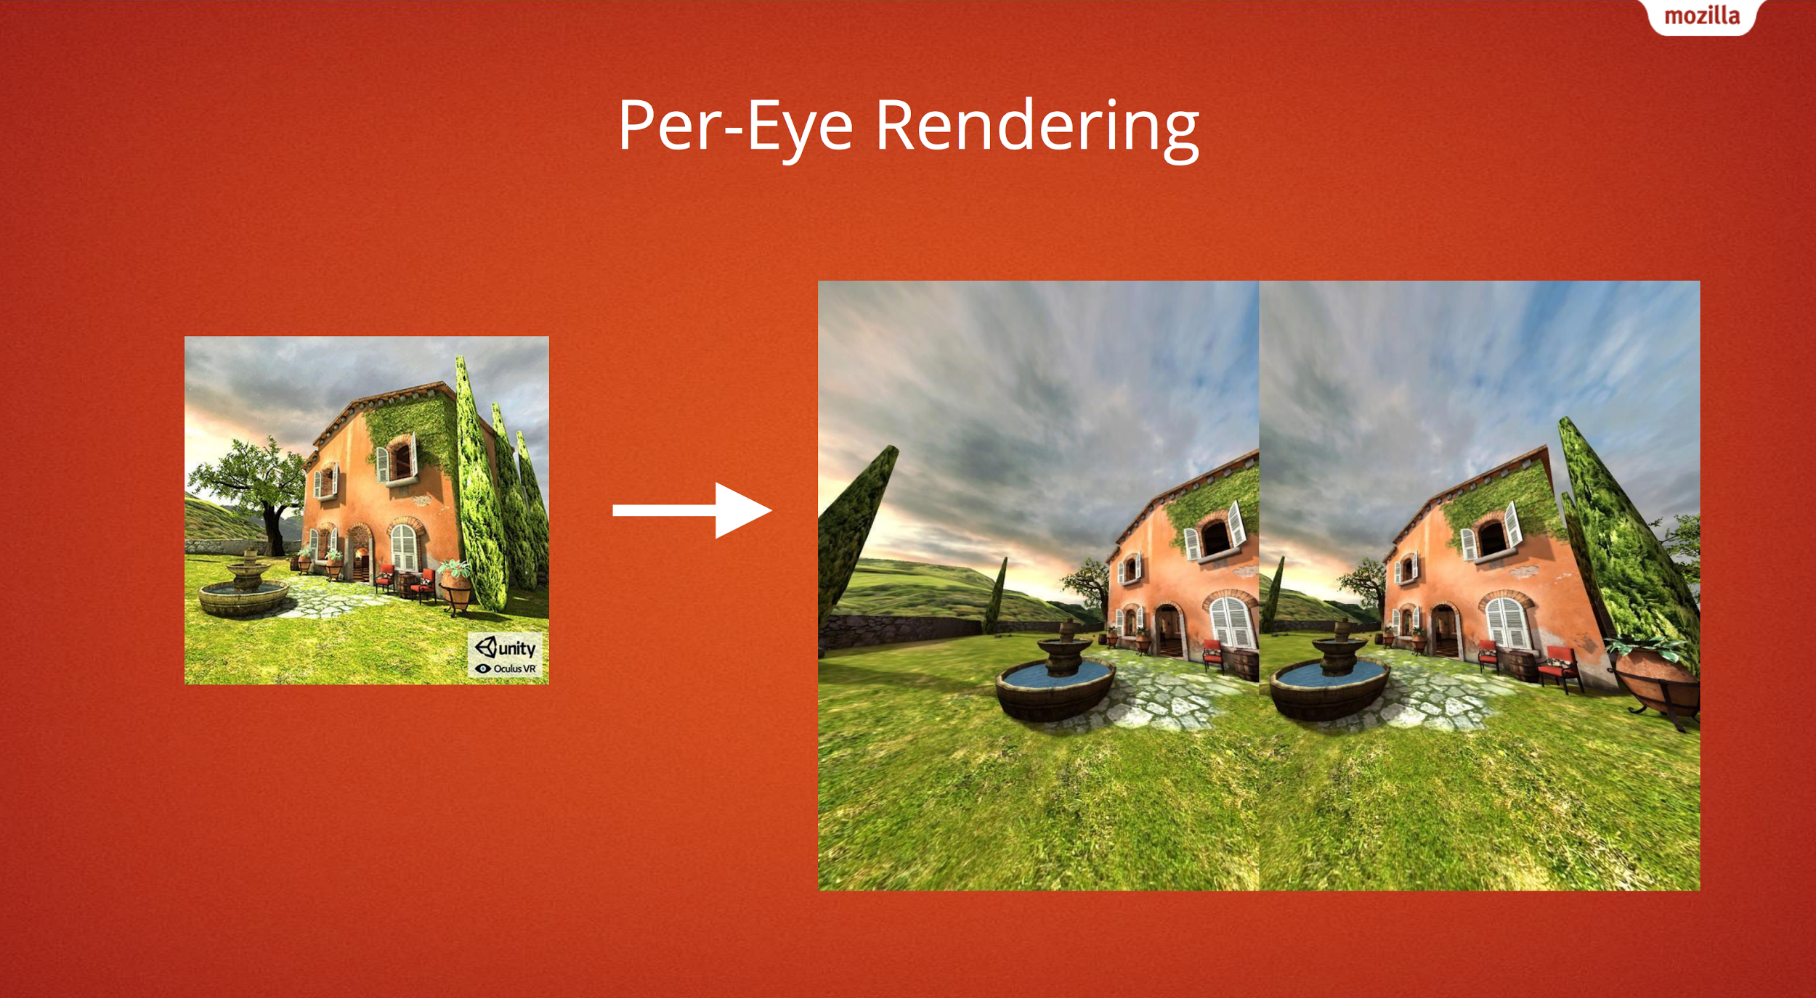
Credit: https://people-mozilla.org/~vladimir/misc/webvr-fitc.pdf

Slide 8
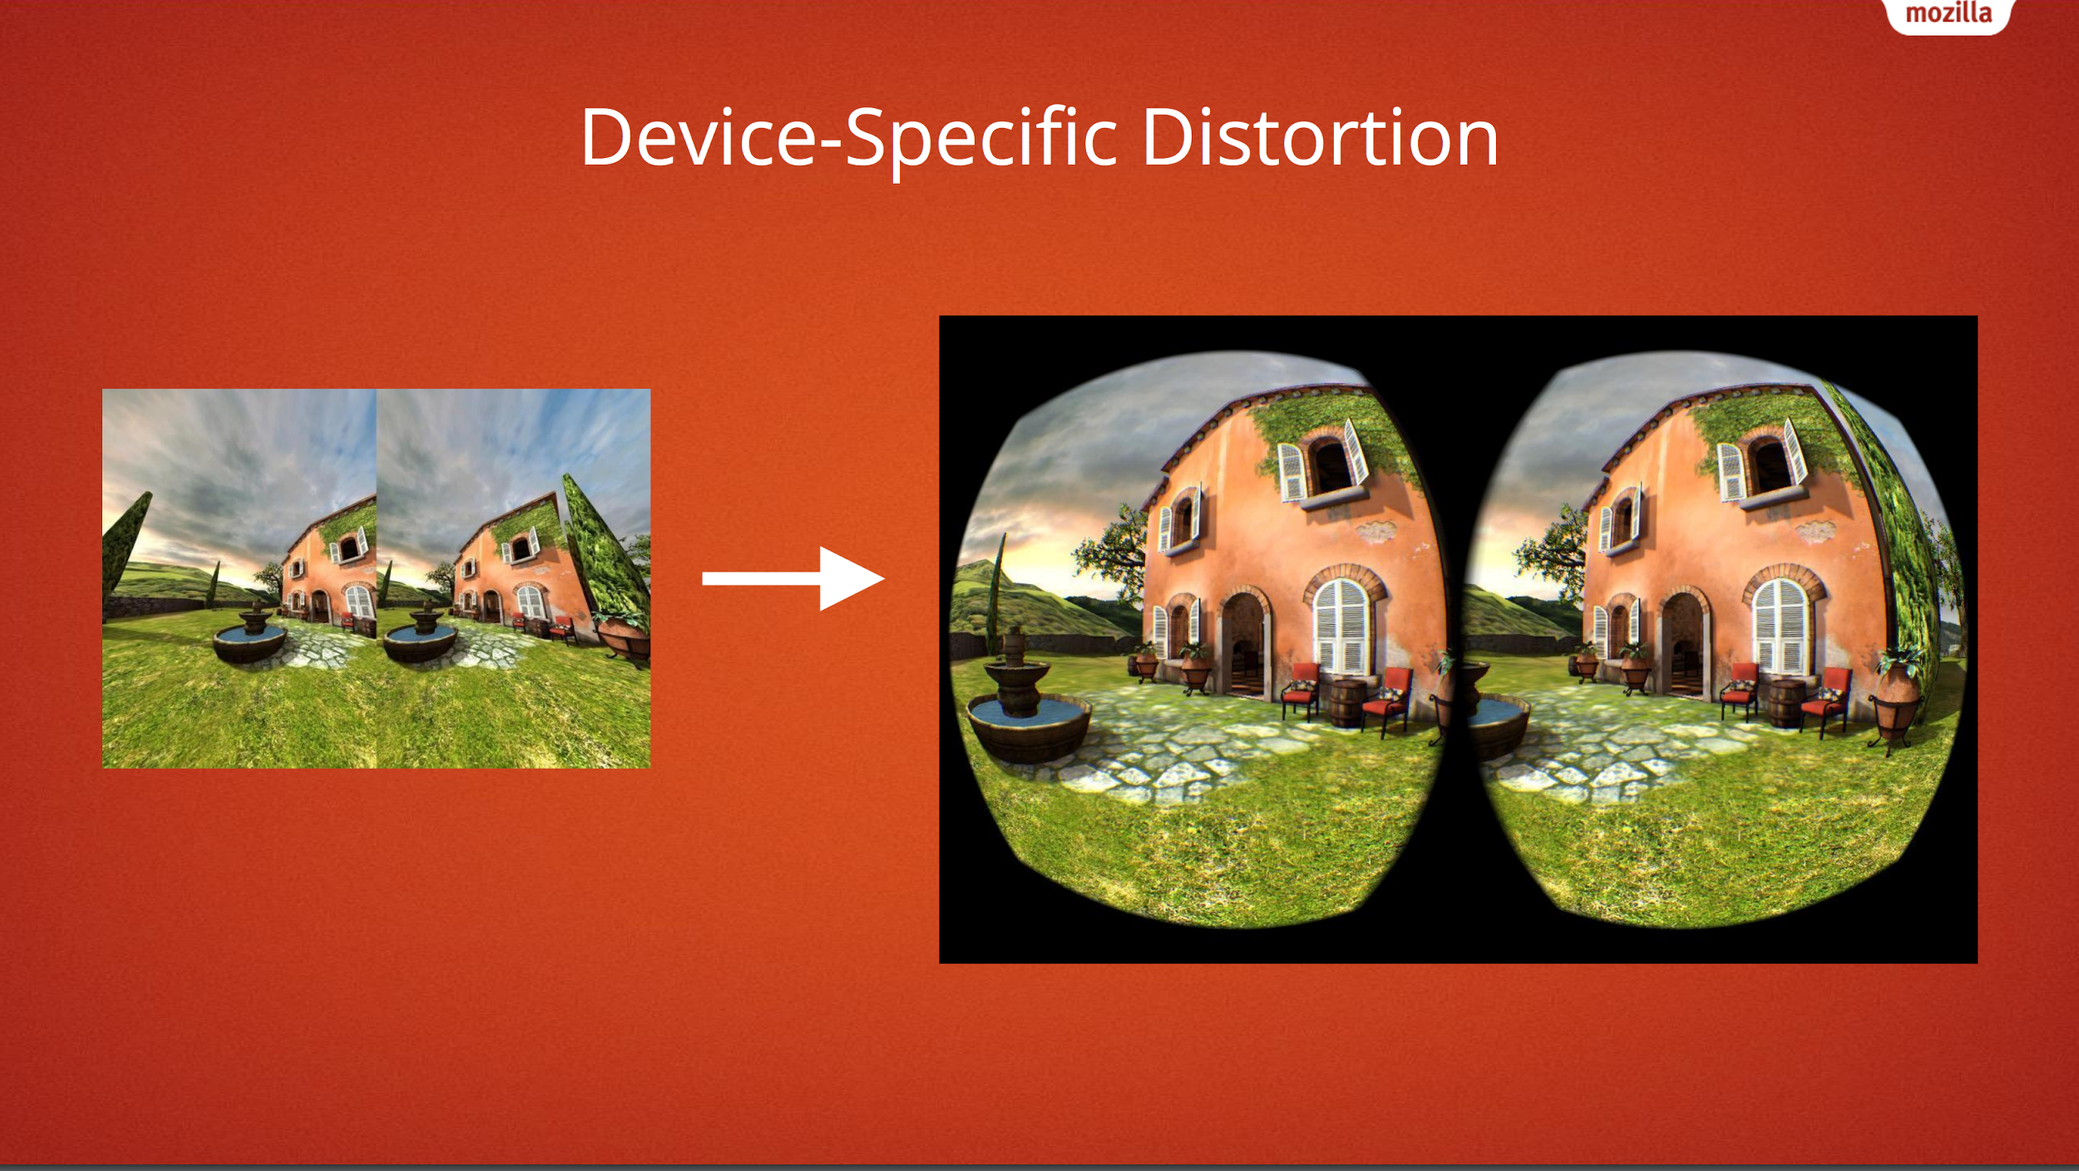
Credit: https://people-mozilla.org/~vladimir/misc/webvr-fitc.pdf

Slide 9
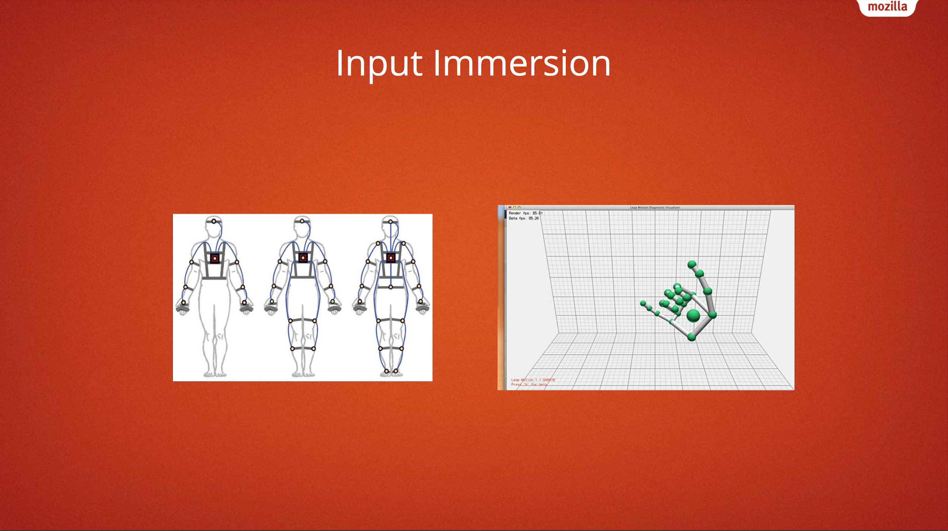
Credit: https://people-mozilla.org/~vladimir/misc/webvr-fitc.pdf

Slide 10
WebVR Overview

Slide 11
What is WebVR?
WebVR is a JavaScript API for creating immersive 3D, Virtual Reality experiences in your browser.

Slide 12
Why WebVR?
Pros:
Hardware Agnostic: Same code easily accessible across VR devices
Easy for Users: Does not require downloading and installing specialized software per experience
Open, Accessible, and Linked
Cons:
Lag: Performance may be worse than native application
Development Stack: Forced to use Javascript and WebGL
Under Development: Not yet supported by all browsers; API subject to change

Slide 13
Development for webvr

Slide 14
Get access to the desplay
_getDisplays () {
return navigator.getVRDisplays().then(displays => {
// Filter down to devices that can present.
displays = displays.filter(display => display.capabilities.canPresent);
// Store the first display we find. A more production-ready version should
this._vr.display = displays[0];
this._vr.display.depthNear = DemoVR.CAMERA_SETTINGS.near;
this._vr.display.depthFar = DemoVR.CAMERA_SETTINGS.far;
});
}

Slide 15
Render the scene for each eye
// Get all the latest data from the VR headset and dump it into frameData.
this._vr.display.getFrameData(this._vr.frameData);
// Left eye.
this._renderEye(
this._vr.frameData.leftViewMatrix,
this._vr.frameData.leftProjectionMatrix,
{
x: 0,
y: 0,
w: EYE_WIDTH,
h: EYE_HEIGHT
});
// Right eye.
this._renderEye(
this._vr.frameData.rightViewMatrix,
this._vr.frameData.rightProjectionMatrix, {
x: EYE_WIDTH,
y: 0,
w: EYE_WIDTH,
h: EYE_HEIGHT
});
// Use the VR display's in-built rAF
this._vr.display.requestAnimationFrame(this._update);
// Call submitFrame to ensure that the device renders the latest image from the WebGL context.
this._vr.display.submitFrame();

Slide 16
_renderEye (viewMatrix, projectionMatrix, viewport) {
// Set the left or right eye half.
this._renderer.setViewport(viewport.x, viewport.y, viewport.w, viewport.h);
// Update the scene and camera matrices.
this._camera.projectionMatrix.fromArray(projectionMatrix);
this._scene.matrix.fromArray(viewMatrix);
// Tell the scene to update (otherwise it will ignore the change of matrix).
this._scene.updateMatrixWorld(true);
this._renderer.render(this._scene, this._camera);
}

Slide 17
Recap
What is VR?
Visual Immersion
WebVR pros and Cons
Development with WebVR

Slide 18
Reference
https://people-mozilla.org/~vladimir/misc/webvr-fitc.pdf
http://web.mit.edu/hawksley/Public/IntroToWebVR/Intro-WebVR-slides.pdf
https://developers.google.com/web/fundamentals/vr/getting-started-with-webvr/

